Slide 1



Titolo presentazione sottotitolo
Travlendar+
Milano, XX mese 20XX
Design Document Authors: A. Aimi, R. Bigazzi, F. Collini

Slide 2
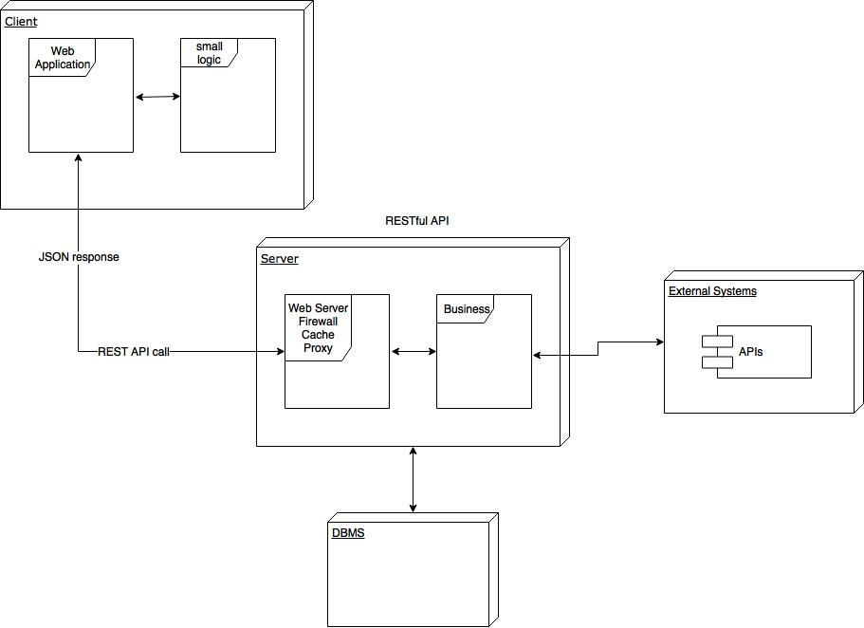
High Level

Slide 3
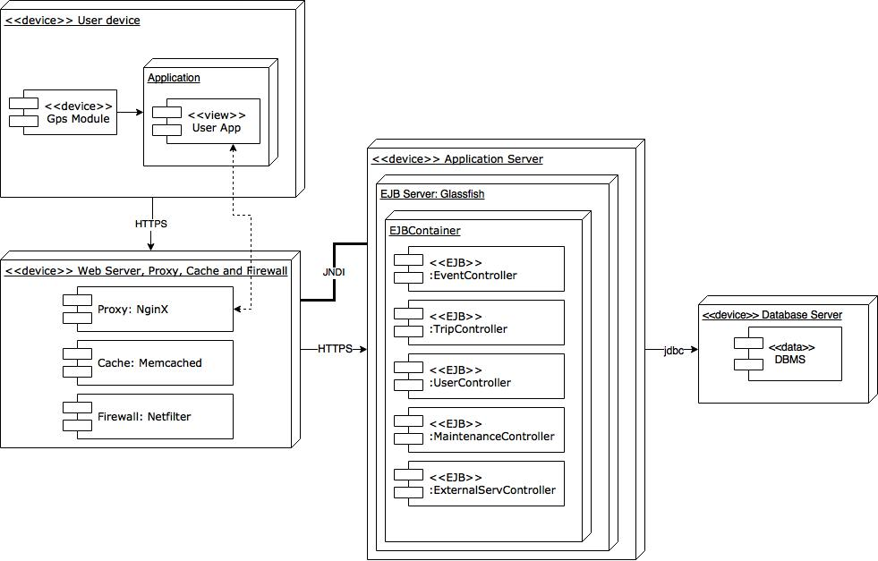
Corresponding Deployment Diagram

Slide 4
Cloud Computing and IaaS
Advantages:
Scalability
Costs
Security
Availability
Constraints:
Stateless Components
Upgrade
Maintenance

Slide 5
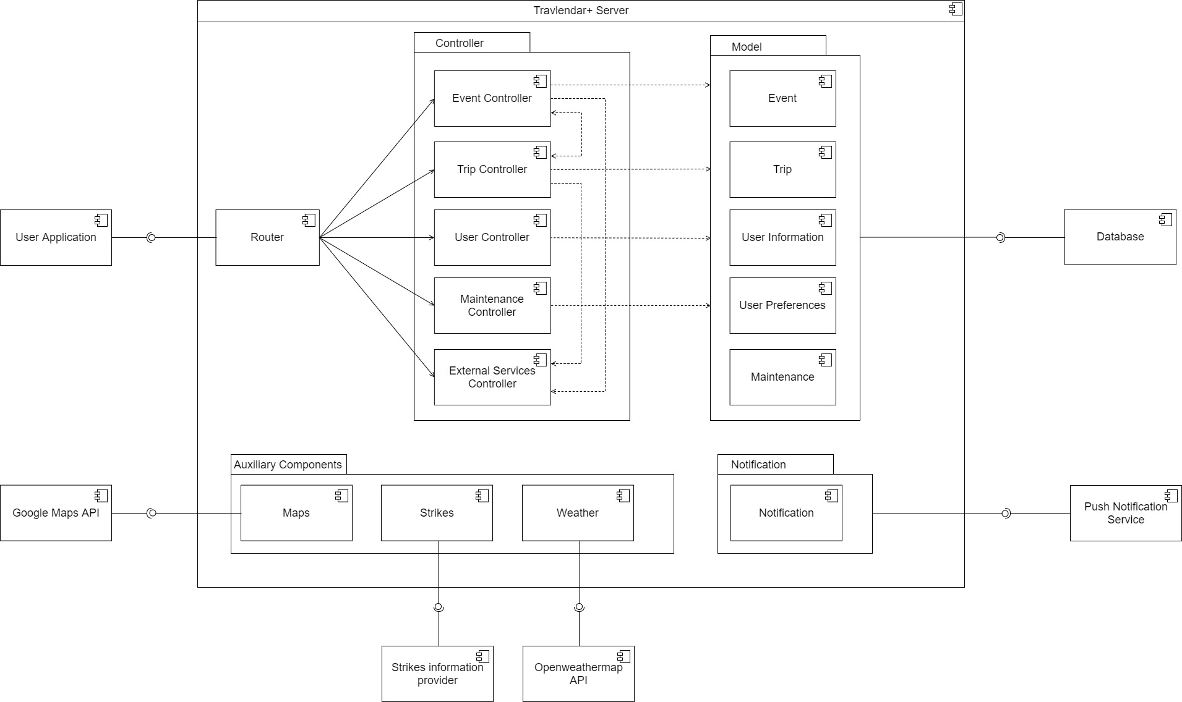
Component Diagram

Slide 6
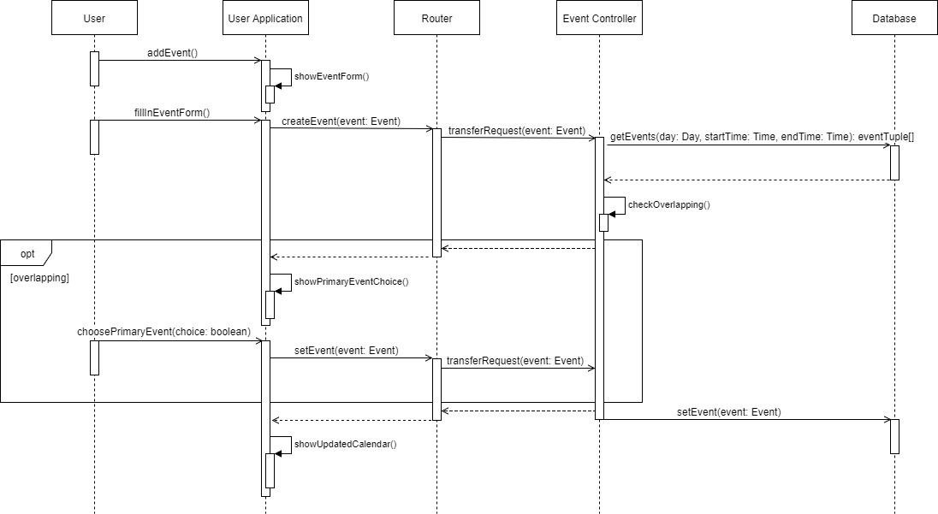
Runtime view – Add event
Runtime view

Slide 7
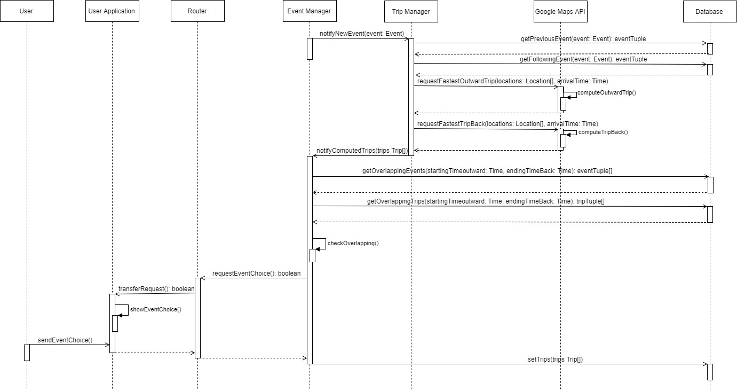
Runtime view – Trip computation

Slide 8
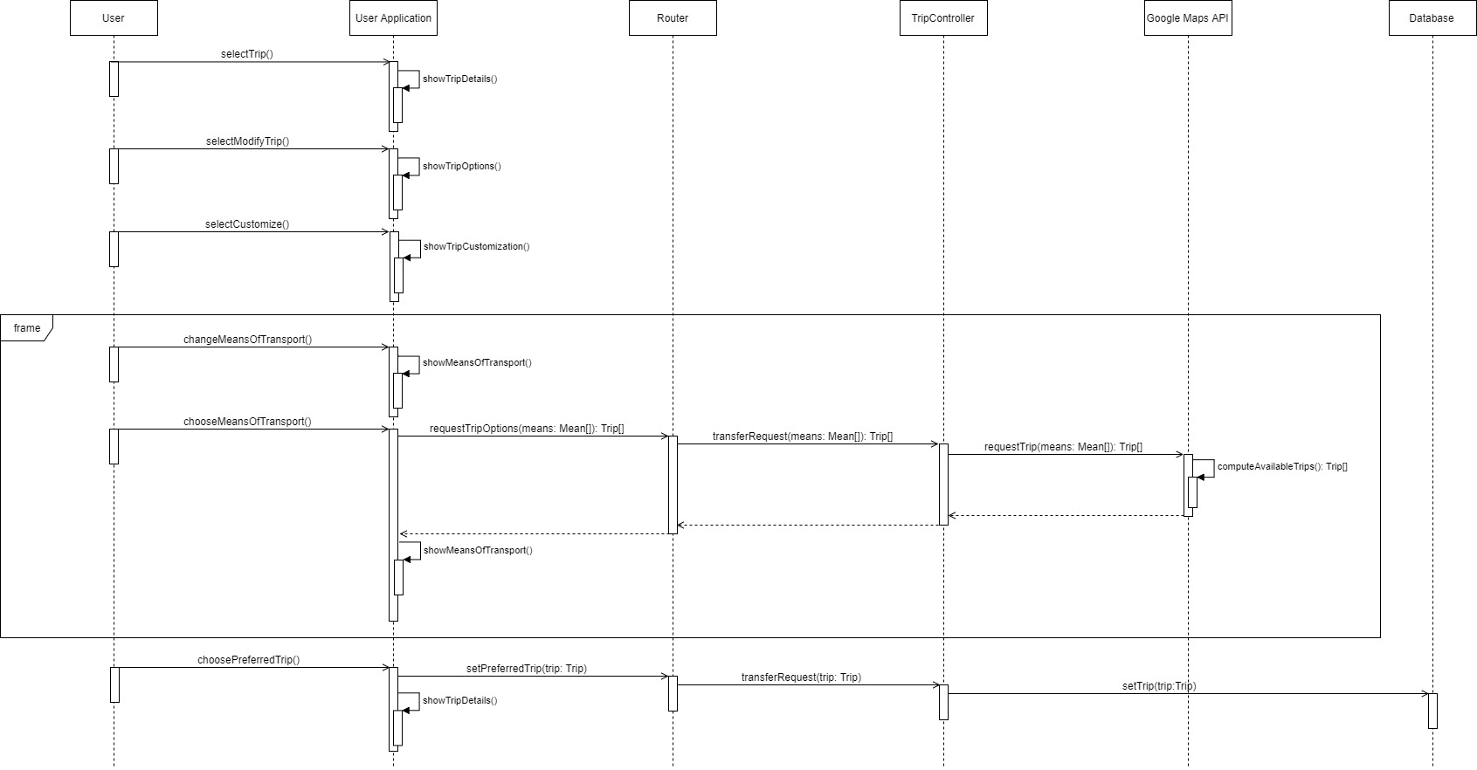
Runtime view – Trip customization

Slide 9
Main decisions
Client-server vs. web application;
Break times allocation;
Primary and secondary events;
Two layer user interface;
Ticket purchase.

Slide 10
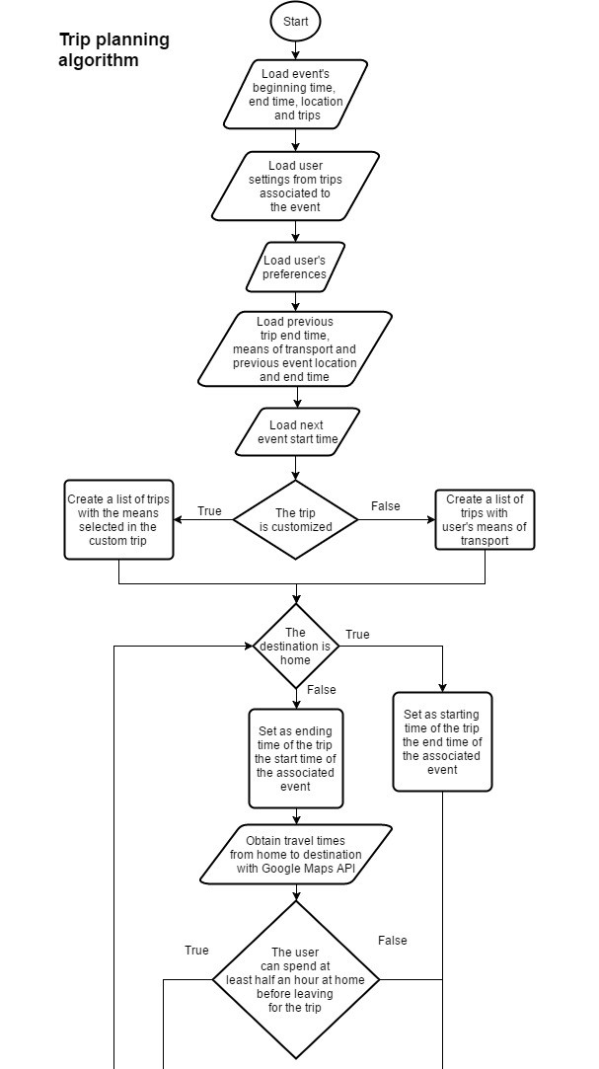
Most important algorithm

Slide 11
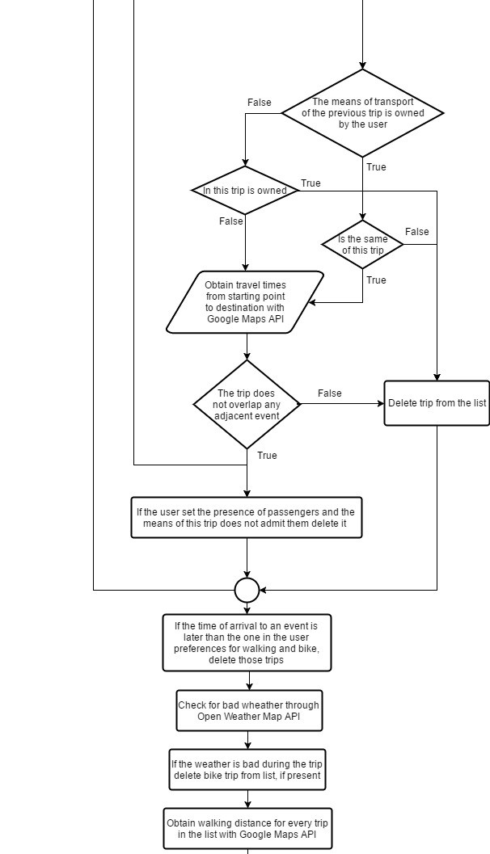
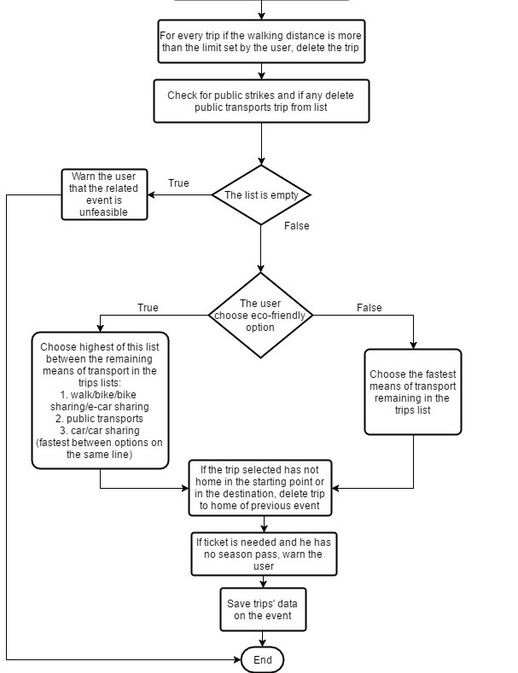
Most important algorithm

Slide 12
Most important algorithm

Slide 13
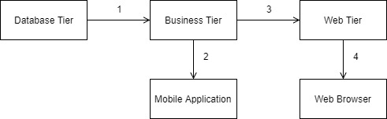
Implementation, integration and test plan

Slide 14
Implementation, integration and test plan
System composition:
Front-end components: mobile application;
Back-end components: the server and its components;
External components: the components which refer to functionalities provided by external systems and the DBMS.
Test plan:
Bottom-up strategy

